Slide 1



Setting up Prometheus and Grafana into the Kubernetes Cluster
Prometheus is a free software application used for event monitoring and alerting. It records real-time metrics in a time series database built using a HTTP pull model, with flexible queries and real-time alerting.
Grafana is a multi-platform open source analytics and interactive visualization web application. It provides charts, graphs, and alerts for the web when connected to supported data sources. It allows us to query, visualize, alert on, and understand our metrics no matter where they are stored.

Slide 2
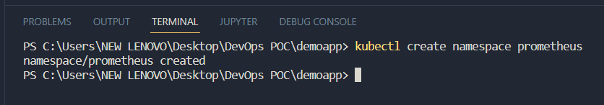
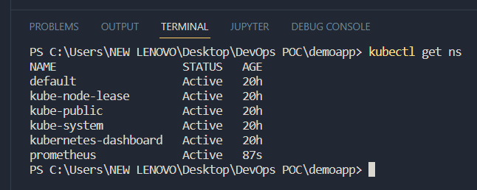
Steps for installation—
1) Run the kubectl create namespace prometheus command to create a namespace.
2) Run the kubectl get ns command to view the list of namespaces created.
3) Install helm.

Slide 3
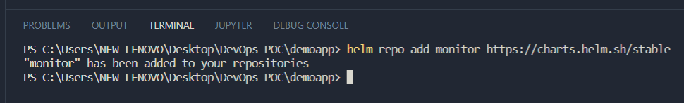
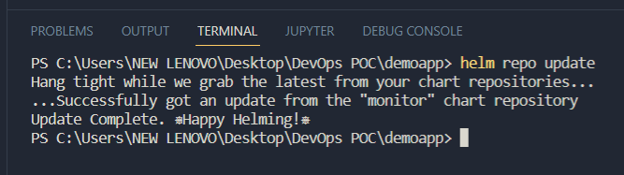
3) Run the helm repo add monitor https://charts.helm.sh/stable command to add monitor repository .
4) Run the helm repo add prometheus-community https://prometheus-community.github.io/helm-charts command to add prometheus-community repository.
5) Run the helm repo update command to update the latest information about charts from the respective chart repositories.

Slide 4
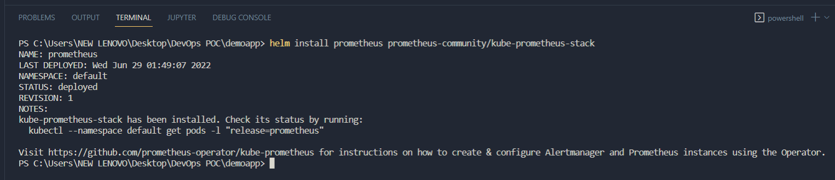
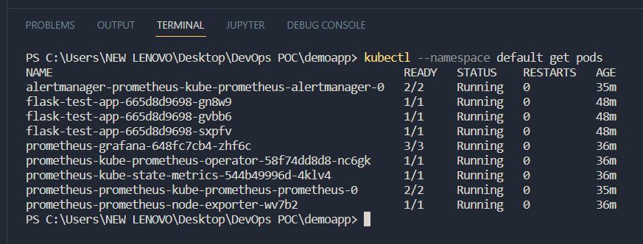
6) Run the helm install prometheus prometheus-community/kube-prometheus-stack command to install Prometheus and Grafana.
7) Run the kubectl –namespace default get pods command to view the list of pods created.

Slide 5
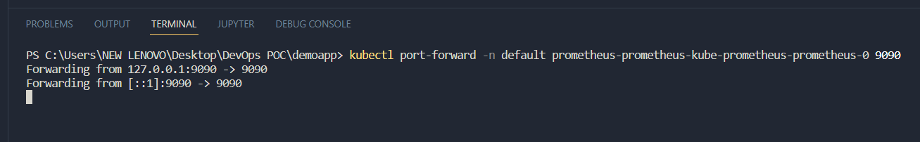
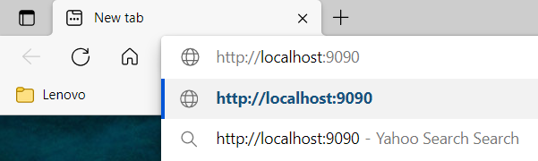
8) Run the kubectl port-forward –n <namespace> <name of prometheus-kube pod> 9000 to set up a proxy that will forward all traffic from a local port that we specify to a port associated with the Pod that we determine.
9) Go to a browser and type 127.0.0.1:9090 as the url and press Enter to access the service.

Slide 6
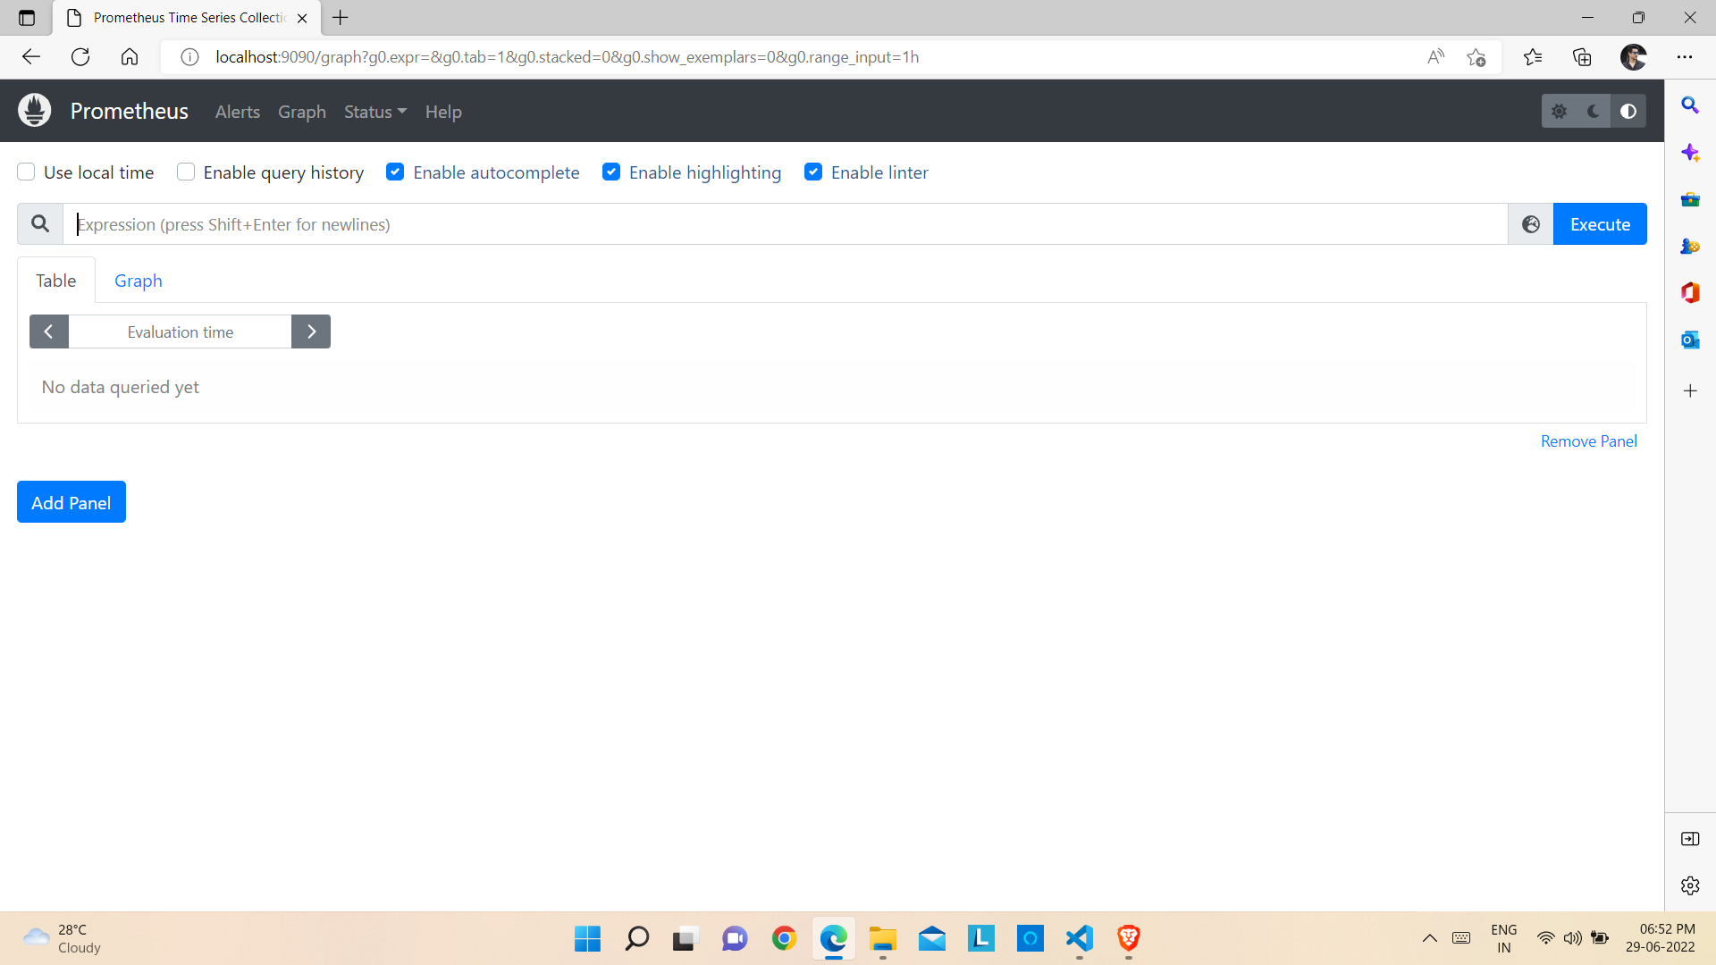
Prometheus Dashboard

Slide 7
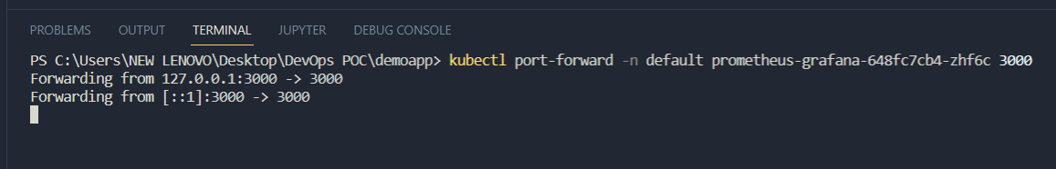
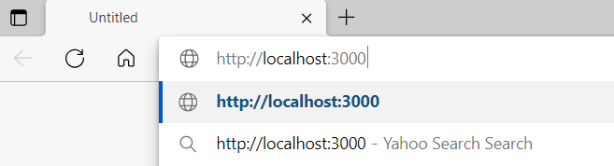
10) Run the kubectl –namespace default get pods command again to view the list of pods created.
11) Run the kubectl port-forward –n <namespace> <name of the prometheus-grafana pod> 3000 to set up a proxy that will forward all traffic from a local port that we specify to a port associated with the Pod that we determine.
12) Go to a browser and type 127.0.0.1:3000 as the url and press Enter to access the service.

Slide 8
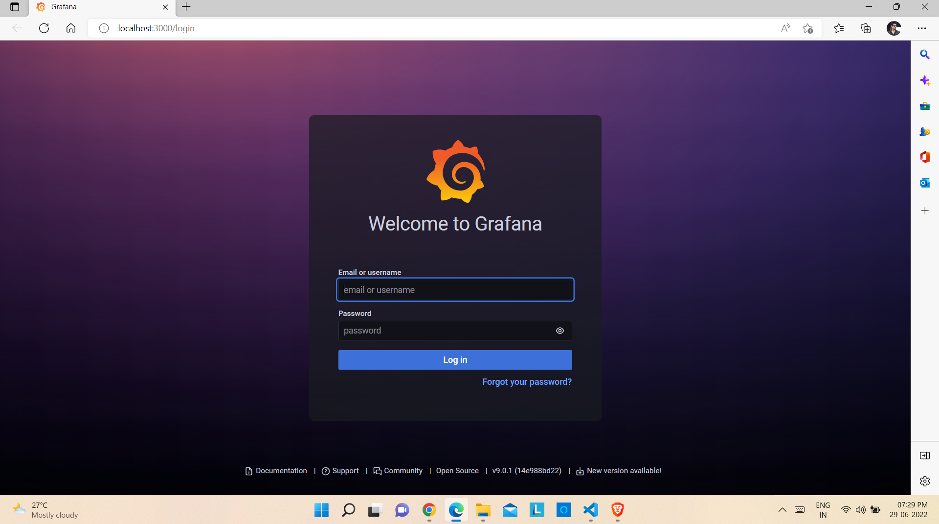
Grafana Login Page

Slide 9
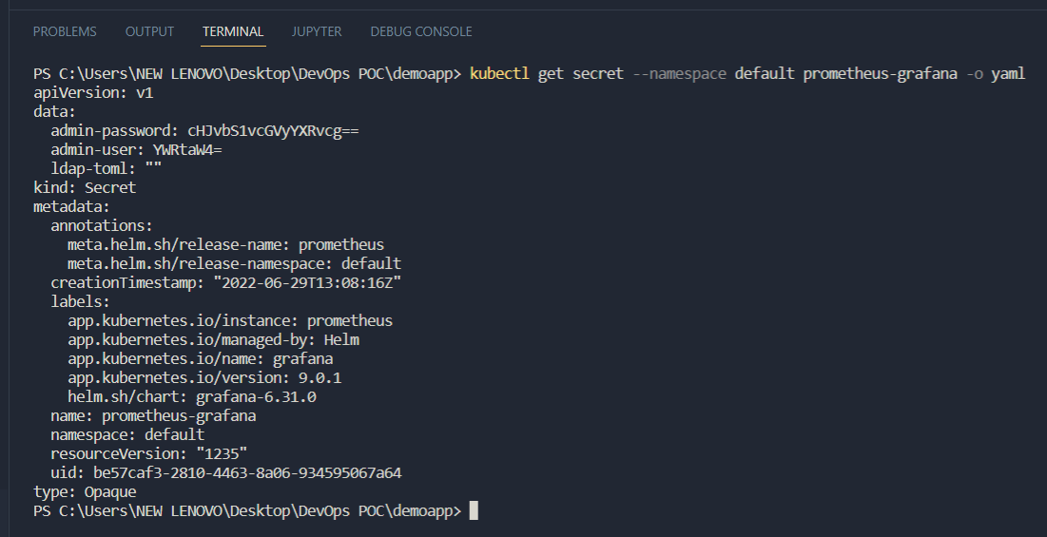
13) Run kubectl get secret –namespace <name of namespace> prometheus-grafana –o yaml command to check the encoded username and password for logging into Grafana dashboard.

Slide 10
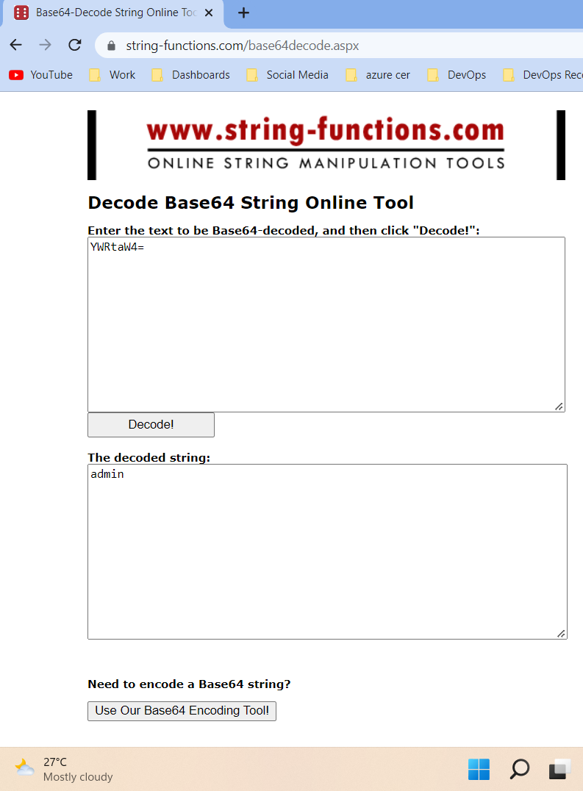
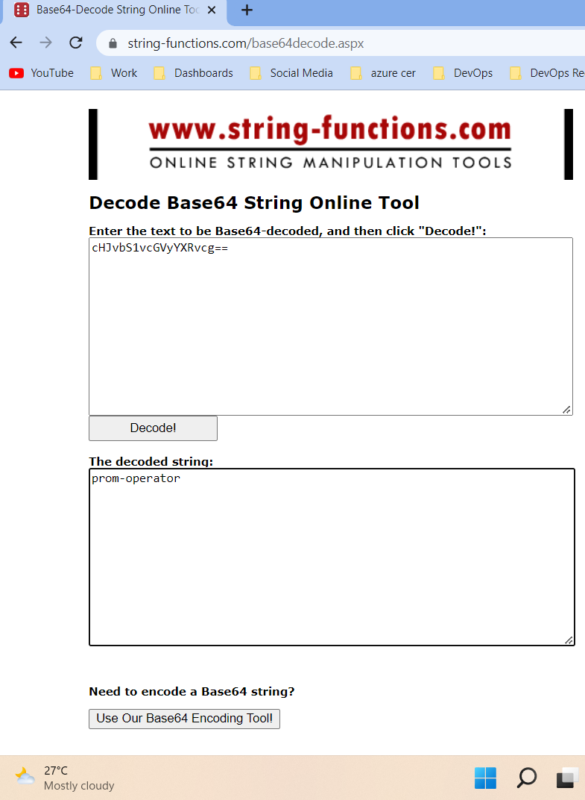
14) Open any online string decoder (For example, https://string-functions.com/base64decode.aspx) and decode the username first and then the password.

Slide 11
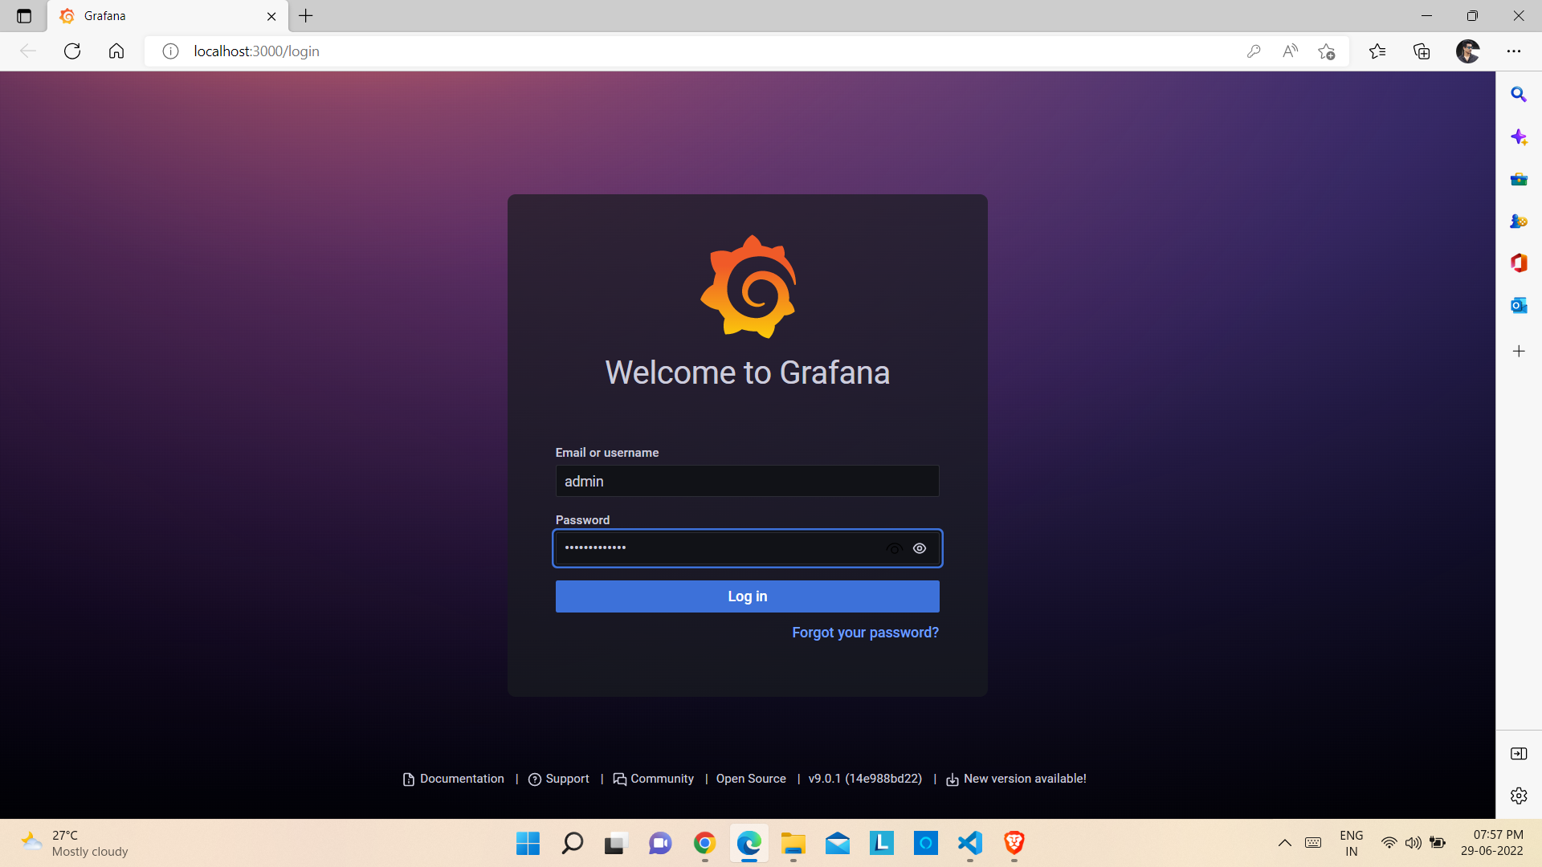
15) Enter the Username and Password on the Grafana login page and click on Log In.

Slide 12
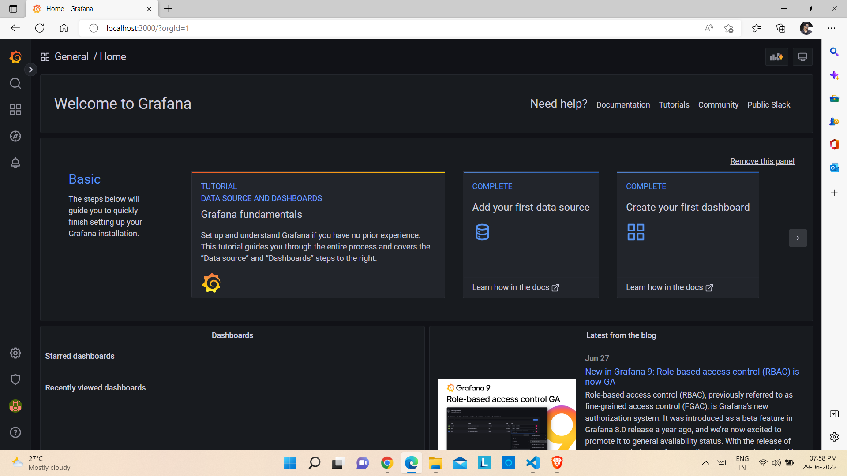
Grafana Dashboard

Slide 13
Thank you !

